Slide 1
RATIONAL STATEMENT
"An analytical method was conducted using the Happy_Dataset.csv in answer to Mr. John Hughes' request regarding predicting a student's change in standardised score following training. This dataset includes seven variables and 143 observations. The variables include things like housing expenses, public school quality, street and pavement maintenance, social community events available, and the availability of information about city services. Values 0 for dissatisfied and 1 for cheerful correspond to the decision attribute, which is represented by the dependent variable 'D'.

Slide 2
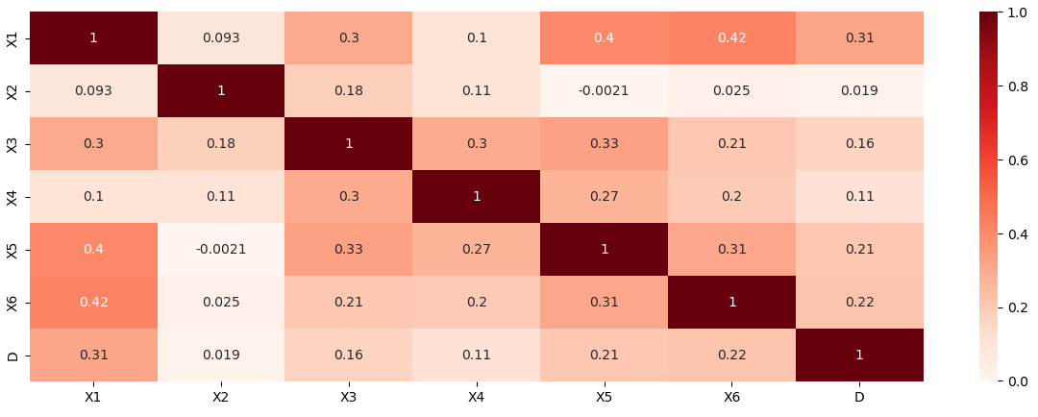
HEAT MAP
Low Correlation with Housing Costs: The cost of housing, or X2, has very low correlations with all other variables, including happiness (D), which has almost no correlation at all. This may suggest that, given the data, housing costs had no bearing on happiness or the accessibility of the other services and characteristics examined.
Street/Sidewalk Maintenance and Public Schools: With a coefficient of 0.33, there is a clear positive link between X5 (street and sidewalk maintenance) and X3 (the general quality of public schools). This could imply that people consider public school quality to be higher in regions with superior public infrastructure.

Slide 3
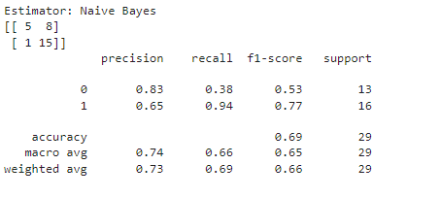
Naïve Bayes
1. When it comes to forecasting cheerful pupils, the Naive Bayes model shows a precision of 0.65, meaning that 65% of predicted instances of happiness turn out to be correct. Still, there is potential for improvement in terms of lowering false positives. 2. A restriction in the model's capacity to identify instances of sadness is highlighted by the recall of 0.38 for predicting unhappy students. This leads to a larger false negative rate, indicating that the ability to recognise disgruntled pupils has to be improved. 3. With a moderate balance between recall and precision, the F1-score of 0.77 highlights areas for development in both areas. Despite an overall accuracy of 0.69, the uneven support highlights the importance of taking class distribution into account. More refining is necessary for reliable predictions in both happy and unhappy classes.

Slide 4
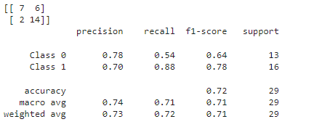
Logistical Regression
1. Accuracy & Precision: When it comes to predicting happy pupils, the Logistic Regression model shows a precision of 0.70, which denotes a reasonable level of accuracy with 70% of predictions being accurate. Still, there is potential for improvement in terms of lowering false positives. With an overall accuracy of 0.72, the classifications are generally considered correct.
2. Recall and False Negatives: With a recall of 0.54 for sad students, the model only accounts for 54% of real-world cases of unhappiness. This implies that there may be a barrier to accurately detecting unhappy situations, which could result in a greater number of false negatives.
3. Balanced F1-Score and Model Refinement: The F1-score of 0.78 indicates a strong overall balance in predicting accuracy by reflecting a balanced assessment of precision and recall. To further improve the model's performance, however, there is room for improvement in both precision and recall, especially with regard to reliably recording occurrences of both happiness and dissatisfaction. When interpreting these measures, class distribution must be taken into account.

Slide 5
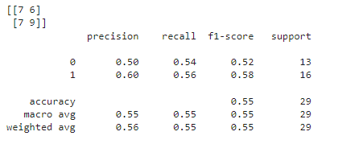
Neural Network
Precision and Recall Balance: Observation: The Neural Network model is able to accurately predict 60% of the occurrences of pleased students (Class 1) with a precision of 0.60. Recall for dissatisfied students (Class 0) is 0.54 (i.e., 54% of real unhappy instances are captured by the model). This highlights an effort to prevent both false positives and false negatives and implies a very balanced strategy between recall and precision.
F1-Score and Model Performance: Observation: The F1-score, which is equal to 0.58, is a harmonic mean of recall and precision. This metric, which is balanced, shows that the Neural Network model keeps precision and recall in a healthy proportion. Still, there is room for development in both areas to raise the total level of prediction accuracy.
Macro Average and Overall Accuracy: Understanding: The Neural Network model's overall accuracy, expressed as a percentage of correctly categorised occurrences out of all instances, is 0.55. With a national average F1-score of 0.55, it appears that student performance is balanced across classrooms. The model's capacity to manage class imbalances is shown in the weighted average F1-score, which stands at 0.55.

Slide 6
Model Recommendation
Logistic Regression
Reasoning: With a precision of 0.70 for predicting happy students, a recall of 0.54 for predicting unhappy students, and an overall accuracy of 0.72, the Logistic Regression model exhibits a balanced performance. Its 0.78 F1-score indicates that recall and precision are well-balanced. This implies that the model is a good fit for class prediction since it keeps a fair balance between preventing false positives and false negatives.

Slide 7
Possible Improvements
Feature Engineering:
Hyperparameter Tuning:
Justification: Enhance the model's predictive power by exploring feature engineering. Think about adding more pertinent features or developing new features that could be able to identify more complex patterns in the data. For instance, merging or altering current features may reveal connections that help produce a prediction of student satisfaction that is more accurate.
Justification: To further enhance the model's performance, adjust its hyperparameters. Look for the best hyperparameter values systematically, taking into account factors such as learning rates, iteration limitations, and regularisation strength. This can be accomplished by using strategies like random or grid search, which try to optimise the model for increased predictive accuracy and improved generalisation.

